Slide 1
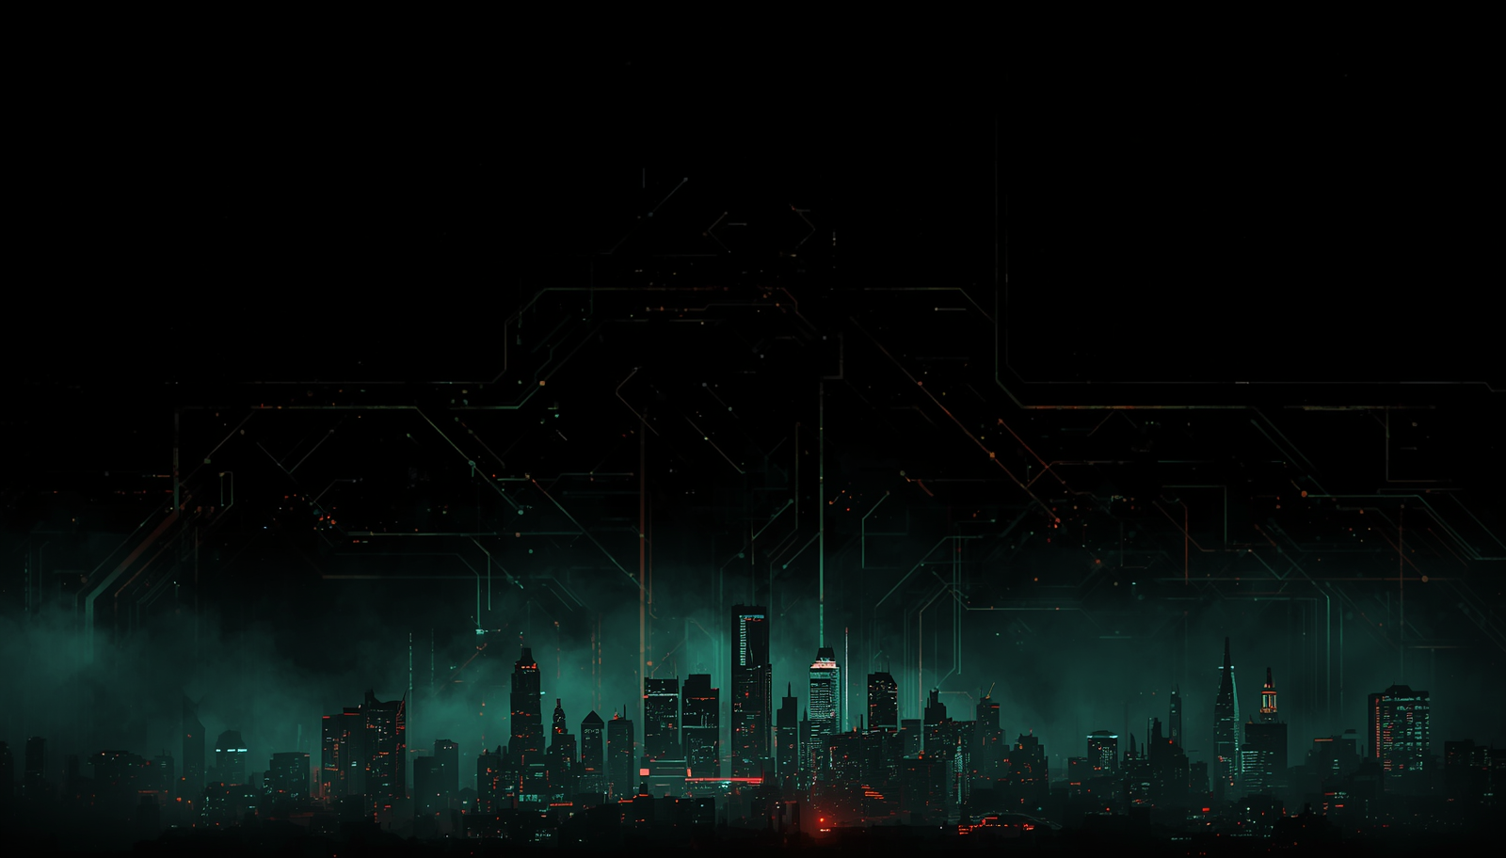

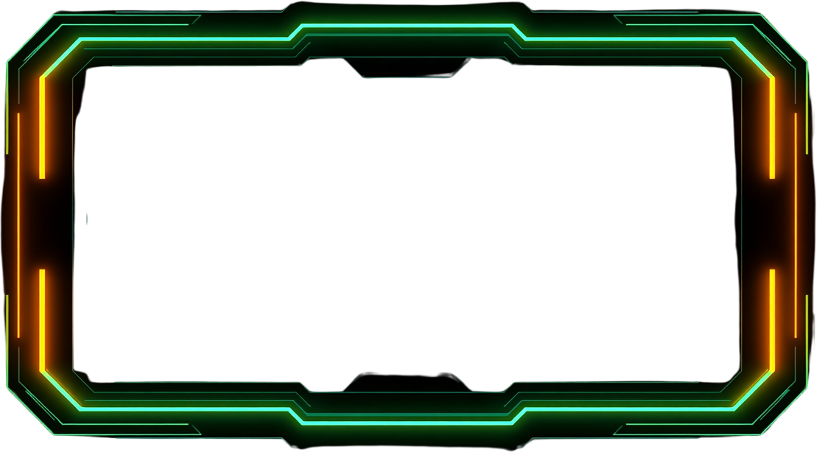

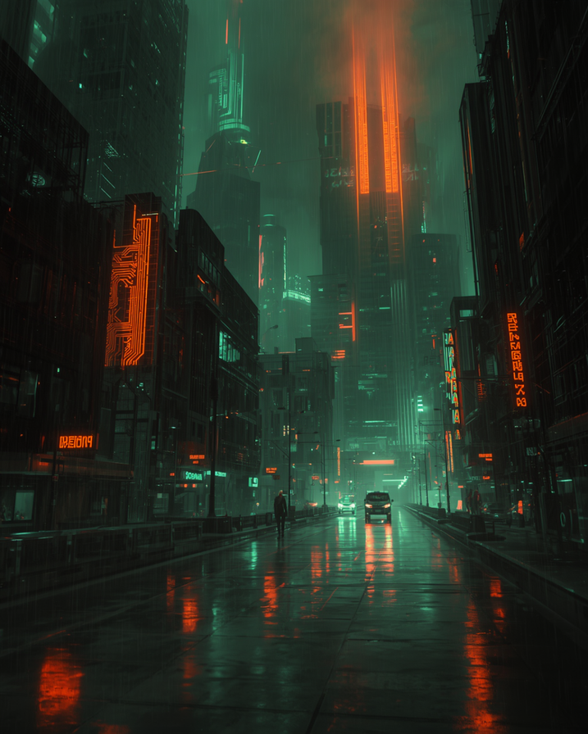
IETE
CHAPTER
NEXT SLIDE
2898 A.D:
THE FINAL DROP
Bridging Core Electronics Concepts with Immersive Pop-Culture Gamification. A Story-Driven, Gamified ECE Experience Stall.
PAGE 01

Slide 2

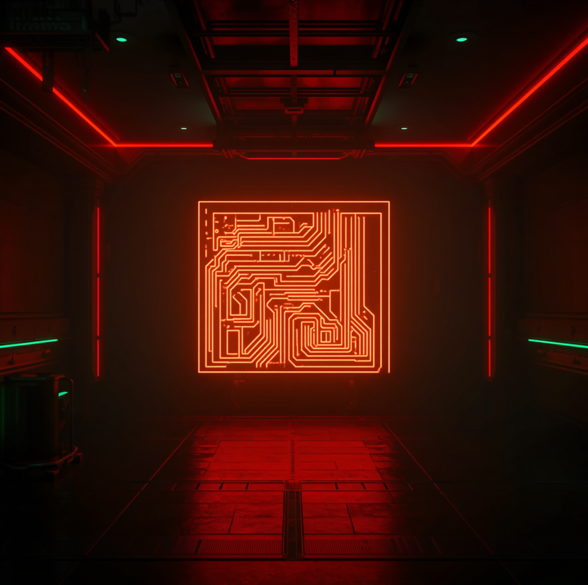

IETE
CHAPTER
NEXT SLIDE
EXECUTIVE
SUMMARY
Objective & Core Concept
Attract diverse students to the ECE stall through immersive gamification. A 4-level solo gamified maze inspired by dystopian sci-fi worldbuilding — accessible to all departments, no prior ECE knowledge required.
Event Highlights
Crowd-friendly format with 6–8 min/player throughput for smooth queue management. Low-cost, fully reusable hardware setup ensuring high engagement, maximum footfall, and an unforgettable Tech Fest experience.
PAGE 02

Slide 3
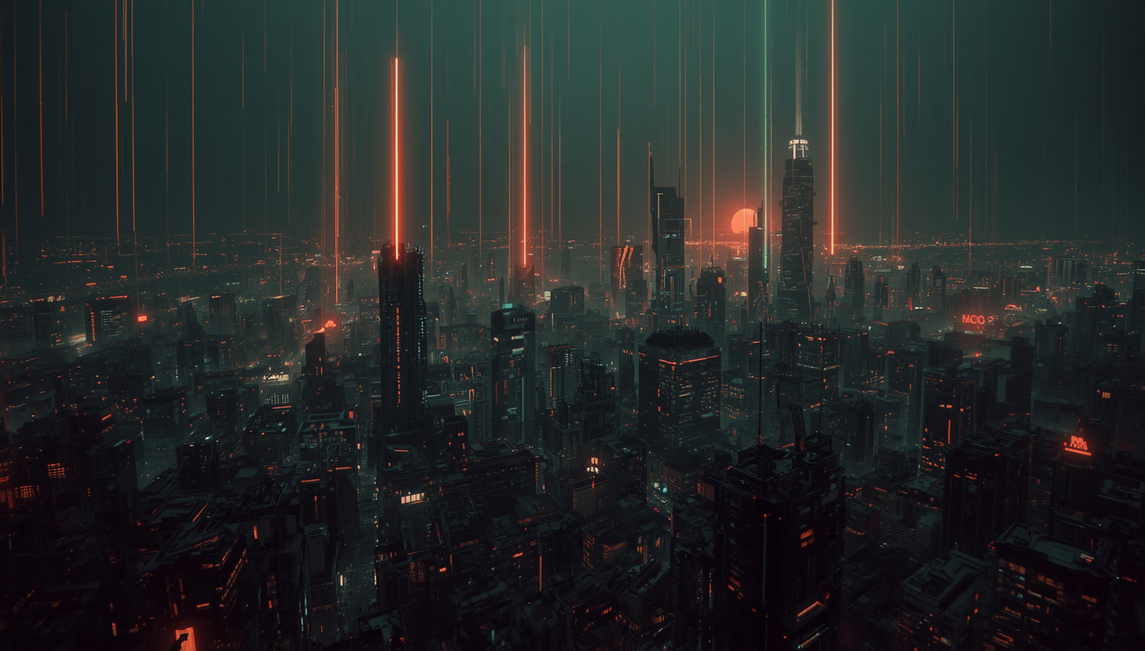


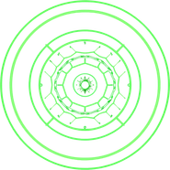

IETE
CHAPTER
NEXT SLIDE
NARRATIVE &
LORE FRAMEWORK
The Storyline
Roles & Factions
Purpose & Design
Year 2898 A.D. — The Serum is lost. Players become Bounty Hunters traversing four dangerous zones: Kashi → Sector 7 → New World → Shambhala. Each zone is a gauntlet of ECE challenges standing between the Hunter and the cure. Complete all levels to retrieve the Serum and save humanity.
Participants = Hunters on a solo mission. Volunteers = Complex Raiders — enforcers guarding each zone. Failure means capture and exile to the Flux Lands trap zone, where one retry is earned only by sacrificing an energy prop. Every role is immersive and thematic.
The lore lowers the entry barrier for non-ECE students by wrapping technical puzzles in an engaging narrative. No prior electronics knowledge needed to begin — curiosity and instinct guide players in, while real ECE concepts reward those who dig deeper.
PAGE 03

Slide 4


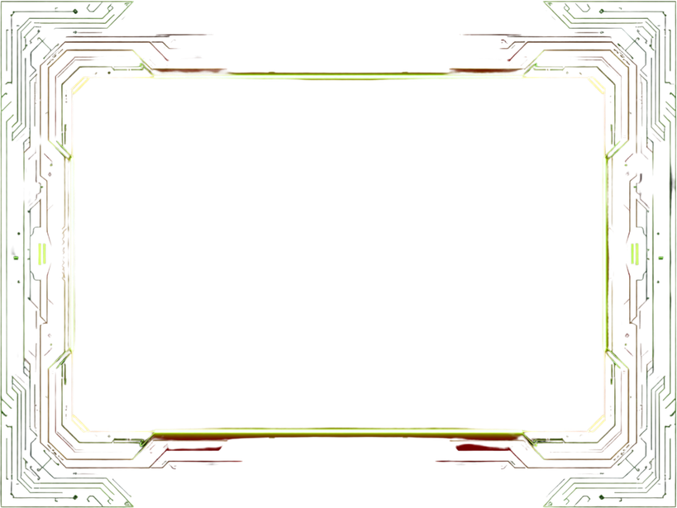
IETE
CHAPTER
NEXT SLIDE
GAME MECHANICS &
TECHNICAL LEVELS
LEVEL 1: KASHI — SOMA ACTIVATION
LEVEL 2: SECTOR 7 — RAIDER LOGIC GRID
CONCEPT: Path of Least Resistance / Circuit Shorting
GAMEPLAY: Navigate a wire-loop and switch maze to form zero-resistance paths. Players must identify and complete the correct circuit to activate the SOMA module and advance.
SKILL: Basic circuit theory, short-circuit logic, resistance analysis.
CONCEPT: Digital Logic & Binary-to-Decimal Conversion
GAMEPLAY: Decode encrypted bounty codes using 4-bit toggle switches within 60 seconds. Players convert binary inputs to decimal outputs to unlock the Raider Grid and proceed.
SKILL: Binary arithmetic, digital logic gates, time-pressure decision-making.
PAGE 04

Slide 5

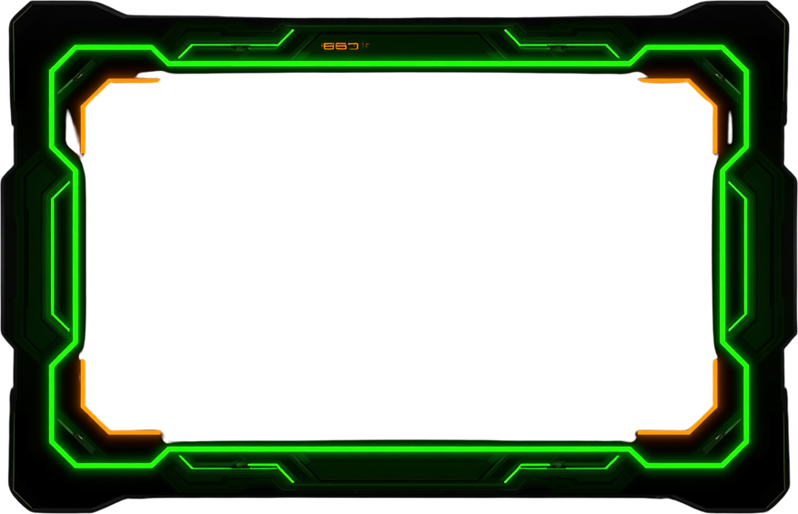

STUDIO
SHODWE
NEXT SLIDE
GAME
MECHANICS
Level 3: New World — Rebel Signal Intercept
Level 4: Shambhala Gate — Serum Verification
CONCEPT: Signals & Systems — Waveform Matching & SNR
GAMEPLAY: Tune a potentiometer to morph chaotic waveforms into a target sine wave. Match the signal within tolerance to intercept the Rebel broadcast and unlock the path to Shambhala.
SKILL: Analog signal intuition, frequency awareness, noise filtering.
CONCEPT: 2's Complement & Voltage Dividers
GAMEPLAY: Multi-phase challenge — calculate 2's complement of encoded bounty codes, then verify voltage output using a multimeter on a resistor divider circuit. Correct values unlock the Serum vault.
SKILL: Binary arithmetic, circuit measurement, precision.
PAGE 05

Slide 6





IETE
CHAPTER
NEXT SLIDE
EVENT OPS
& FLOW
Playtime & Throughput
Failure State & Retry
Environment & Setup
Each player completes the full 4-level maze in 6–8 minutes, ensuring smooth queue management and high participant turnover throughout the event. Efficient reset mechanics keep wait times minimal and energy high.
Players who fail a level are diverted to the FLUX LANDS trap zone. One retry is granted upon sacrificing an energy prop token — adding dramatic stakes and maintaining immersive narrative tension within the experience.
Hall stall features a dark backdrop, red neon LED strips, ambient radio chatter audio, and thematic dystopian props — serum vials, laminated hint cards, and foam panels — creating a fully immersive cyberpunk atmosphere.
PAGE 06

Slide 7

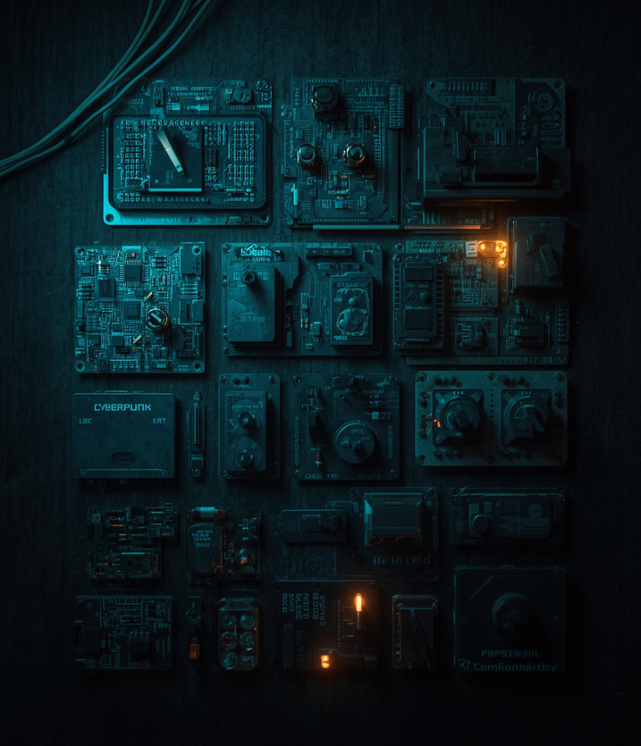
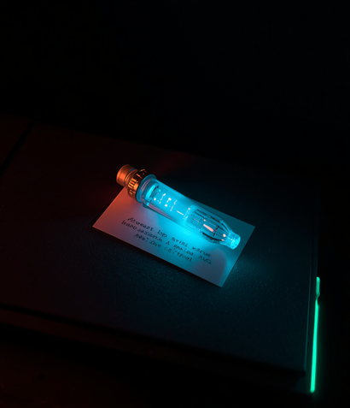
SERUM
HUNT
NEXT SLIDE
RESOURCE &
BUDGET
Electronics & Hardware
Arduino / 555 timer circuits, toggle switches, LEDs, potentiometers, resistors, batteries, multimeters. All components are low-cost, widely available, and fully reusable across multiple event runs with fast-reset mechanics.
Props, Ambience & Reusability
Laminated hint cards, foam panels, LED serum vials, thematic posters, neon LED strips. Circuits are fully reusable with minimal downtime between players — maximizing throughput and minimizing operational cost.
PAGE 07

Slide 8

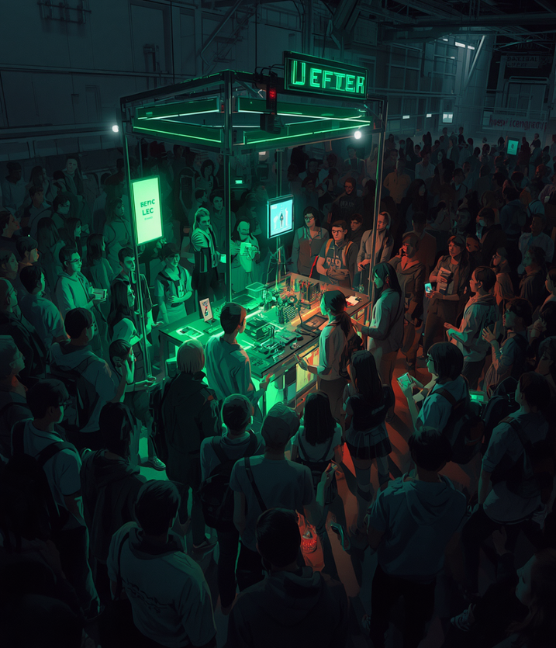

IETE
CHAPTER
NEXT SLIDE
AUDIENCE
ENGAGEMENT
Inclusivity & Difficulty Design
Layered difficulty with hint cards ensures access for ALL departments — ECE, CSE, Mech, and Biotech. Marketing arsenal: eye-catching queue posters bearing "NOW BEGINS THE END", immersive volunteer costumes as Complex Raiders, and thematic pass cards to drive foot traffic.
Rewards & Retention
Winners and participants receive branded stickers, acrylic keychains, and reward envelopes — ensuring every Hunter leaves with a memento. High perceived value drives word-of-mouth and repeat queue engagement throughout the fest.
PAGE 08

Slide 9



2898 A.D.
SERUM HUNT
NEXT SLIDE
CONCLUSION &
CALL TO ACTION
WHY THIS PROPOSAL DELIVERS
► Elevates the ECE stall profile at University Tech Fest, positioning it as the most immersive and talked-about experience on the floor.
► Demonstrates core engineering principles — circuit logic, signal systems, binary math — in an engaging, story-driven format accessible to all departments.
► Crowd-friendly throughput of 6–8 min/player ensures high turnout and sustained queue engagement throughout the event.
NEXT STEPS
► Approval for dedicated stall space and layout clearance from the fest organizing committee.
► Budget sign-off for hardware components, props, LED ambience, and reward items.
► Final venue setup coordination with volunteer briefing and dry-run testing before event day.
"The Serum Hunt is not just a game — it is proof that electronics is alive, urgent, and worth pursuing."
PAGE 09

Slide 10
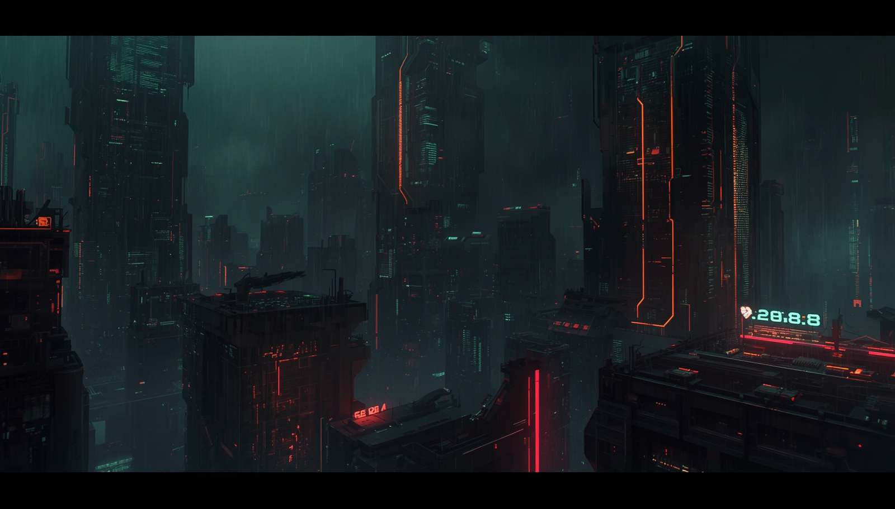
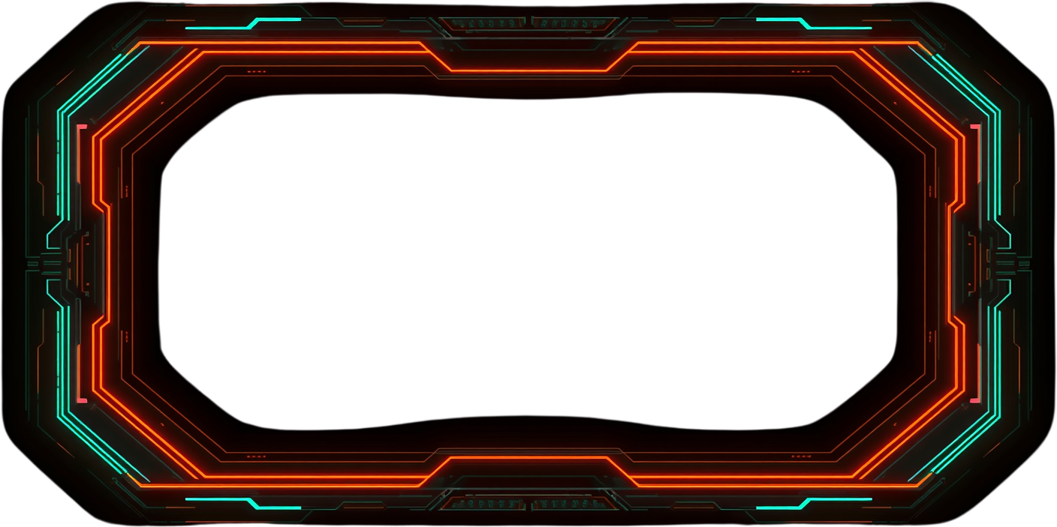
SERUM
HUNT
BACK
THANK YOU!
Thank you for your consideration. We welcome your questions.
Contact: team.serumhunt@ece.edu | +91-XXXXX-XXXXX | IETE Chapter, ECE Department
PAGE 10

